Slide 1
Component
Provider
Type
Name
resource "azurerm_resource_group" "example" {
name = "example"
location = "West Europe" }
Resource Configuration

Slide 2
INIT
DESTROY
PLAN
APPLY

Slide 3

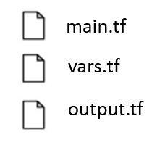
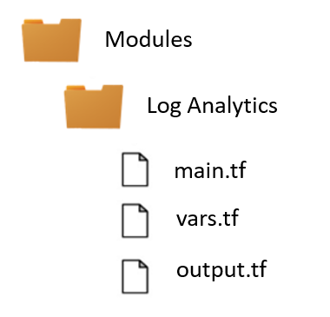

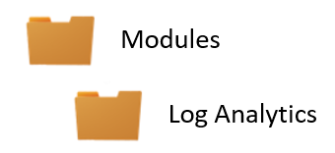


Solution
App Service
Log Analytics
main.tf
vars.tf
output.tf

